Slide 1

Week 3
Rejection sensitivity and growth

Slide 2
Opener Questions
1. Name a time when someone criticized you and they were wrong.
2. Name a time when someone criticized you and they were right.
3. Did those criticisms feel different?
4. Do you have someone in your life you feel safe enough with to receive constructive criticism from?

Slide 3
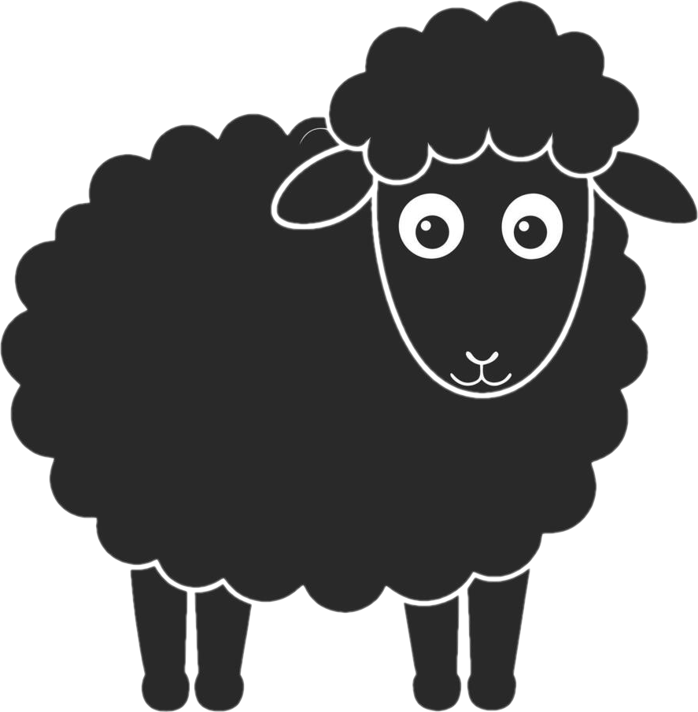
Verses
Proverbs 12:1 “Whoever loves discipline loves knowledge, but he who hates reproof is stupid.”
Hebrews 12:11 “For the moment, all discipline seems painful rather than pleasant, but later it yields the peaceful fruit of righteousness.”

Slide 4
Verses
Revelation 3:19 “Those whom I love I reprove and discipline, so be zealous and repent.”
Galatians 5:1 “It is for freedom that Christ has set us free. Stand firm then, and do not let yourselves be burdened again by a yoke of slavery.”

Slide 5
Verses
John 8:31-32 “So Jesus said to the Jews who had believed him, ‘If you abide in my word, you are truly my disciples, and you will know the truth, and the truth will set you free.’”
2 Corinthians 10:5 “We demolish arguments and every pretension that sets itself up against the knowledge of God, and we take captive every thought to make it obedient to Christ.”

Slide 6
What is Rejection Sensitivity Dysphoria?
According to the Cleveland Clinic, it is Intense emotional pain related to rejection or criticism, where one is more likely to interpret vague interactions as rejection. It is connected to emotional dysregulation (emotional responses do not match the circumstance) and is commonly seen in people with ADHD and autism.
Processing rejection and/or criticism is a frontal-lobe activity. Additionally, the criticism we receive for being neurodivergent compounds over time making one more sensitive to real criticism (Newport Institute).

Slide 7
Symptoms
1. Easily embarrassed or self-conscious.
2. low self-esteem or not believing in oneself.
3. Anger, crying, withdrawing, or beating self-up.
4. depression.
5. People pleasing or striving for perfection.
6. Assigning attentions to criticism that may not exist (ex: My boss suggested changes to the report I made, therefore they don’t like me/don’t think I am right for the position).

Slide 8
We’ve spent so much of our lives being misunderstood that when we’re rightfully called out on something, it can feel like the same. Our responses to rejection and/or critique are then judged as spiritual shortcomings rather than disordered brain structure. Here’s where it gets tricky: Even though rejection sensitivity is not sin like pride, it can prevent us from growth and transformation.

Slide 9
Rejection sensitivity | Pride
Intense fear of failure or rejection. | Positive self-assessment of one’s achievements or character.
Looks down on self or frustrated from being misunderstood. | Inflated sense of self-worth or achievement.
Focused on preventing pain. | Focused on maintaining image.
When rejected, feels unwanted or unworthy. | When rejected, feels anger, but not less worthy.

Slide 10
Tools to embrace growth

Slide 11
1. Identify rejection sensitivity for what it is when it is happening and identify what is real. The truth will set you free. Take every thought captive.
2. Use the label, don’t let the label use you. The purpose of identifying RSD should help us overcome it, not to use it as a way to shut down legitimate feedback. It is for freedom Christ has set us free.
These solutions can be difficult to navigate when we’ve experienced abuse of power, and we don’t know who a safe person is and whether their feedback is toxic or helpful.

Slide 12
Reflection Questions
1. Neurodivergent people are capable of being both rejection sensitive and prideful. How can we tell the difference?
2. How can we tell if we’re being misunderstood or if the feedback, we’re receiving is correct?
3. How much time does it take you to know the difference, and what do you do in the meantime (blow everything up in anger or withdraw and disappear)?

Slide 13
Next Meet Up
April 29th
Different ways to pray

